Slide 1
Coding dojo data science project 2
liPING liu January 2023

Slide 2

Business Problem
    According to the World Health Organization (WHO) stroke is the 2nd leading cause of death globally, responsible for approximately 11% of total deaths.
    Predict whether a patient is likely to get stroke based on the input parameters like gender, age, various diseases, and smoking status.
Notes:
Cite: https://www.kaggle.com/datasets/fedesoriano/stroke-prediction-dataset

Slide 3

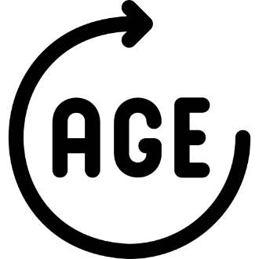




Data Introduction
  5110 entries in the data set.
  Classification Problem- We are prediction whether the patient is likely to get a stroke or not
  In the data set, we have about 95 % who does not have stroke.
  What is BMI ? How do I calculate my BMI?
    Body Mass Index (BMI) is a person's weight in kilograms (or pounds) divided by the square of height in meters (or feet).
Gender
Age
Hypertension
Smoking
Job Type
BMI

Slide 4



Steak holders

Slide 5
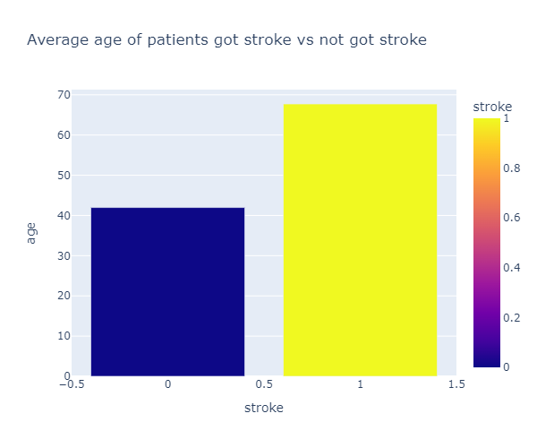

Slide 6
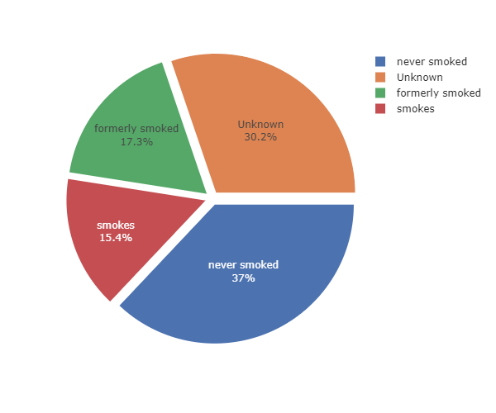

Slide 7
Brief Description
  Binary Classification Problem
  Model: Decision Tree, KNN, Random Forest
  Limitation
    Data is imbalance, we need more information to get better prediction
  Strengths
    Getting to know the relation between feature and target:
      Age and smoking history could be one of the factors that have higher change to get stroke.

Slide 8
Final Recommendation
The final model were chosen has 94% Accuracy
  It does predict well with high accuracy rate but its also caused by not enough data
Need more information to able to predict better and further.
  Especially we need more detail information from people who actually have stroke.

